Slide 1
Capgemini GE HC SDT Program Status

Slide 2
Agenda
Capgemini team Roles and Responsibilities
Project skill set required versus actual
Knowledge transition approach
SDT Modules- Areas where we need KT
Operating Mechanism
SDT Program status
GE Capgemini Confidential

Slide 3
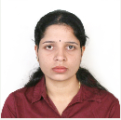
CG team – Roles & Responsibilities
Saraswathi Nagaraj – Project Manager
Location: Offshore – India
Transition Phase ( 8 weeks)
Define and take transition plan to closure
Ensure KT plan adherence, highlight and close gaps
Daily monitoring and tracking of check points after each phase of transition to enable robust implementation
Biweekly status reporting of transition
Highlight Risks related to transition
Stabilization Phase ( 4 weeks)
Closely monitor projects in this phase
Highlight and close gaps
SLA metrics tracking and reporting to monitor continuous performance
Business As Usual :
Managing the relationship with the client throughout the project duration and acting as the main point of contact between GE and Capgemini
Managing resource planning and addressing resources performance issues.
Service Delivery, Product and Project Quality, Project Planning and Tracking, issue management, Risk Management, status tracking, Resource management, Knowledge Management, Team Motivation, co-ordination between support and dev teams, co-ordination with third party teams and resolution of escalations
WSR, MBR & Operational Rhythm.

Slide 4


CG team on call – Roles & Responsibilities
Priya Patra – Program Manager
Location: Offshore – India
Dedicated to GEHC, Delivery Management oversight to CG team, Guidance on project management, Quality Management, Customer management, Resource management, Detailed review of project metrics
Review progress of the project, Regular financial and contractual Activities
Act as lead program integrator between different delivery teams (Siebel , SMAX, TRACE ) to ensure timely resolution of issues
Andrey Reiner – Champion Architect
Location: Onshore - UK
Owns entire architecture end to end
Architecting and solutioning interfaces with Click
Responsible for solutions and design

Slide 5
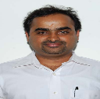
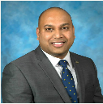
CG team on call – Roles & Responsibilities
Raghavendra JP -Risk and Metrics Manager
Location: Onsite – US
Champions risks and mitigation of the program
Metrics management
Stake holder management
Vamsi Uppu - Transition and Communication Specialist
Location: Onsite – UK
Champions KT
Owner of all communication vehicles
Responsible for P1 and P2 tickets

Slide 6


CG team on call – Roles & Responsibilities
Sajad Abdul – Engagement Owner
Location: Offshore – India
Owns the engagement end to end
Fortnightly health checks for the engagement transition
Acting as the escalation point when issues arise with resources / services and managing any dispute or conflict
Involved in defining the strategic roadmap of the engagement
Gaurav Shukla – Delivery Manager
Location: Offshore - India
Responsible to owning and definition the engagement transition process
Ensuring the services delivered by Capgemini are conform to what has been contractually agreed

Slide 7
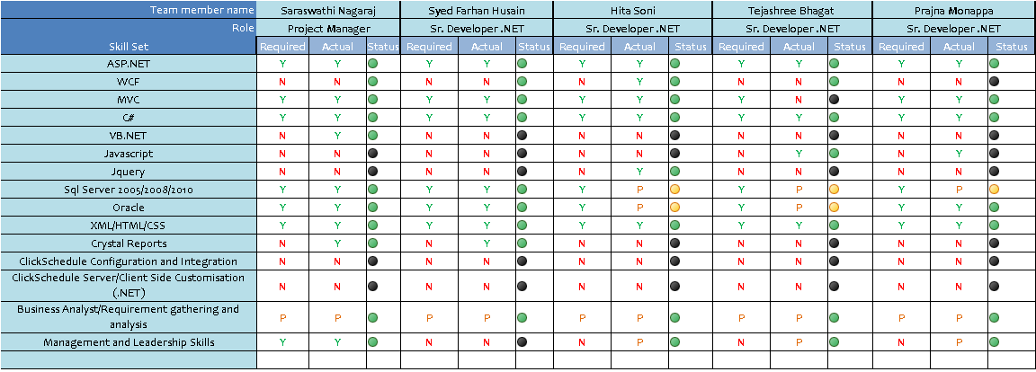
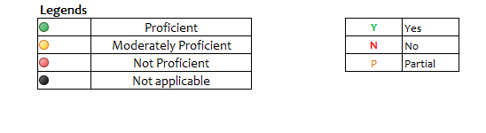
Project skill set required versus actual

Slide 8
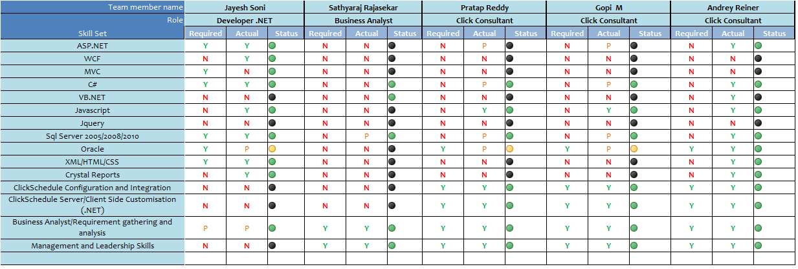
Project skill set required versus actual

Slide 9
Knowledge Transition Approach
Baseline Assessment
and Planning
Self Study
Knowledge Acquisition
Preparation & KT
System profiling
Assessment of knowledge levels
Gap analysis and POC identification
Baseline Inventory
Compute Transition Complexity Index
Workshops and interviews
Questionnaires and walkthrough sessions
One to one sessions with SMEs
System appreciation
Understanding of
existing processes
System Inventory details
KA approach and plan
Identify KA Success Criteria
Setting up of KA and KT teams
Self study of System
Review available documents
Identify gaps in documentation
Reverse engineering
Processes & Tools
Reverse
Presentation
System
Documentation
Acceptance
Review of system documentation
Incorporate review comments
Maintenance Process definition
Verify KA Success Criteria
Reverse Presentation of Knowledge acquired
Confirmation of Knowledge acquired
Gap Documentation
KS of Production support processes
Application architecture
System interaction models
User interface specification
Data models, process structure

Slide 10
SDT Modules – Areas where we need KT
Launch of SDT Booking from Siebel Intl
Request Appointment and Create Visit Without appointment
Early Start & Late Start Mapping against Job Types
UI Screens for different job types & Installation job
Cancel Visit and Modify Visit
SSO ID field population logic
SDT Booking Time Zone Conversion
Part pickup management (adding/removing/modification) of parts list
Part pick-up visit creation
Part Pick-up - Check Address
Same Site or System Dependency Visit creation
Back function to return to SDT Booking Landing page

Slide 11
Operational Excellence Checks
Objectives
Participants
Yearly Workout
Strategic Direction
Long Range Planning
Relationship Vision
Corporate Updates
Risks
Capgemini
GE HC
Strategy (Annual)
Executive Sponsors
CTO and Team
Quarterly Review
Corporate Updates
Industry Updates
Growth Areas
Key Risks
Partnership
(Quarterly)
Steering Committee
Senior Executives
Monthly Review
SLA Review
Value Adds
Actions/ Risks/Issues
Design review
Engagement Owner
Delivery Manager
Client Manager
PM
Program Office
Governance
(Monthly)
Weekly Review
Project/ Service Status
Risks
Backlog prioritization + Grooming
Defect triage
Change req. review/approval
Operations & Support
(Weekly/Bi-weekly)
Leads
Team Leaders
Daily Review
Scrum + Process realignment
Incident Management
Operations & Support
(Daily)
Leads
Team Leaders

Slide 12
RACI Matrix – OpMec Activities
Participant Role
Agenda/
Objective/Purpose
Capgemini
Dev Lead
OpMec Activities
Rohit
Chandra
Sitara
Capgemini
1. Backlog prioritization + Grooming
To prioritize the backlog items, which
can be taken up by team for execution
C
AR
C
I
I
2. Scrum + Process realignment
Review the status and ensure team have
tasks to work upon for the next day
R
R
C
A
A
3. Defect triage
Defects identified during sprint
can be discussed and triaged
C
AR
C
I
I
4. Change request Review/Approval
Changes requested in schedule/Scope/
benefit to be brought up in this meeting
AR
C
C
I
I
5. Pulse and Project Status Meeting
Weekly meeting to update all
on the status and risk/issues
AR
C
C
I
I
6. Leadership Review
Weekly meeting for leadership
AR
AR
AR
7. Vendor Updates
Update from vendors on status and
risks/concerns/issues/Help needed
I
I
I
AR
C
8. Incident Management
Review incidents logged in
SN and traige
AR
AR
9. Design Review
Review SDT architecture
CI
CI
CI
C
AR
Responsible; Accountable; Consulted; Informed

Slide 13
SDT Program Status
Completed
In Progress
To Start
On boarded
To be inducted
GE Decision
GE BGC
Capgemini & GE Onboarding
Capgemini- GE Engagement Induction
Kick Off
Support Area
Staffing
Wk1
Wk2
Wk3
Wk4
Wk5
Wk6
Wk7
Wk8
Wk9
Wk10
Wk11
Wk12
Program Management
Governance
✓ GE GDC compliance policies & training, GE
✓ Creation of SSO ID
✓ Access to libraries, Collab, Folders
✓ Logistics arrangement
CLICK basic awareness training for .NET team by CLICK CoE
✓ Knowledge sharing and best practices used for transitions in major engagements in Capgemini
Program Manager
Project Manager
Program Specific
Business Analyst
SCRUM Master+ .NET
Release Manager
Applications Support
Process familiarization
Knowledge Transition from incumbent vendor
.NET Developers
Resource 7
Resource 8
Resource 6
Resource 9
✓ Six Sigma & ITIL awareness
✓ App security orientation
✓ Basic Support Central & GE libraries
✓ Information Security guidelines
✓ Enterprise standards
Define Standards
Define Implementation Tools
Process Inventory
KT for Process
Create process manuals/documentation
SOP, cold and hot test sign off
Go Live at Capgemini (parallel run)
Incumbent vendor disengagement
CLICK .NET
Resource 10
Application Development
.NET Developers
Resource 11
Resource 13
Resource 12
Resource 14
CLICK .NET
Resource 15

